Slide 1

Environmental Science
Course Overview
23/24
Mrs. Straub
dstraub@alcsny.org

Slide 2

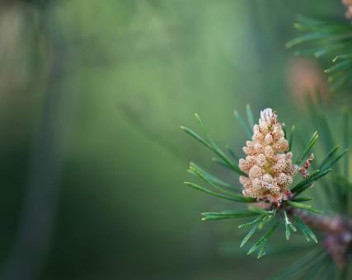
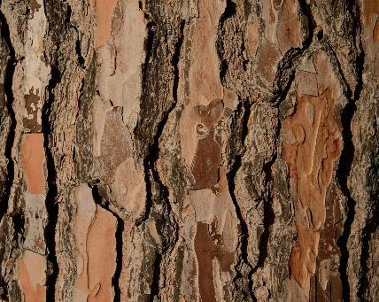

December
Roles of Living Things
Food Chains/Webs
Energy Pyramids/ Biomass
Cycles of Matter

Slide 3



January
Ecosystem Stability (Population growth, Carrying Capacity, Limiting Factors)
Biomes
Human Societies (sustainable development)

Slide 4

Perceptions of Earth:
Global Food Supply
Energy Sources (organic, nuclear, renewable fuel)
February

Slide 5


March:
Energy Sources cont’d
Hydro, Wind, Geothermal, Looking to the future.
Minerals: Uses and Conservation
Soil: Formation, management

Slide 6
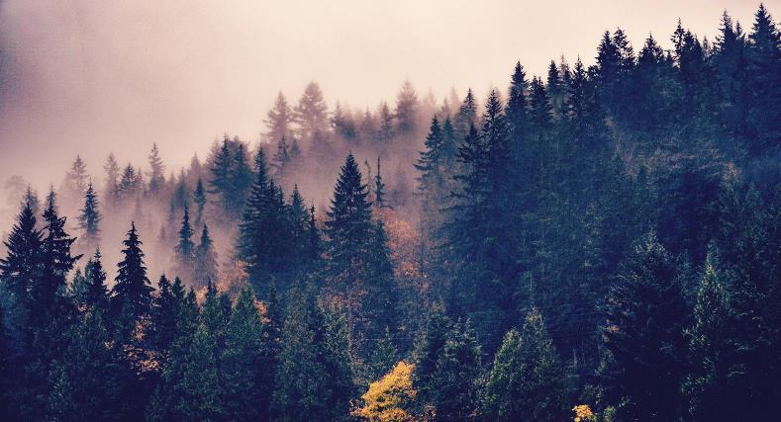

April
Pollution
Water: Resources, Uses, Treatment
Air: Ozone, Global Warming
Managing Human Impact

Slide 7
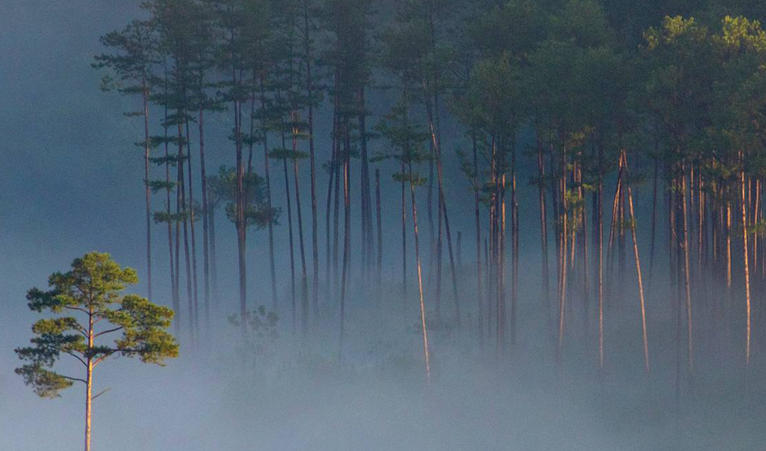
May
Conservation:
Energy, Waste, Protections (local, state, national, global)
Economy vs. Ecology
Global Agenda

Slide 8
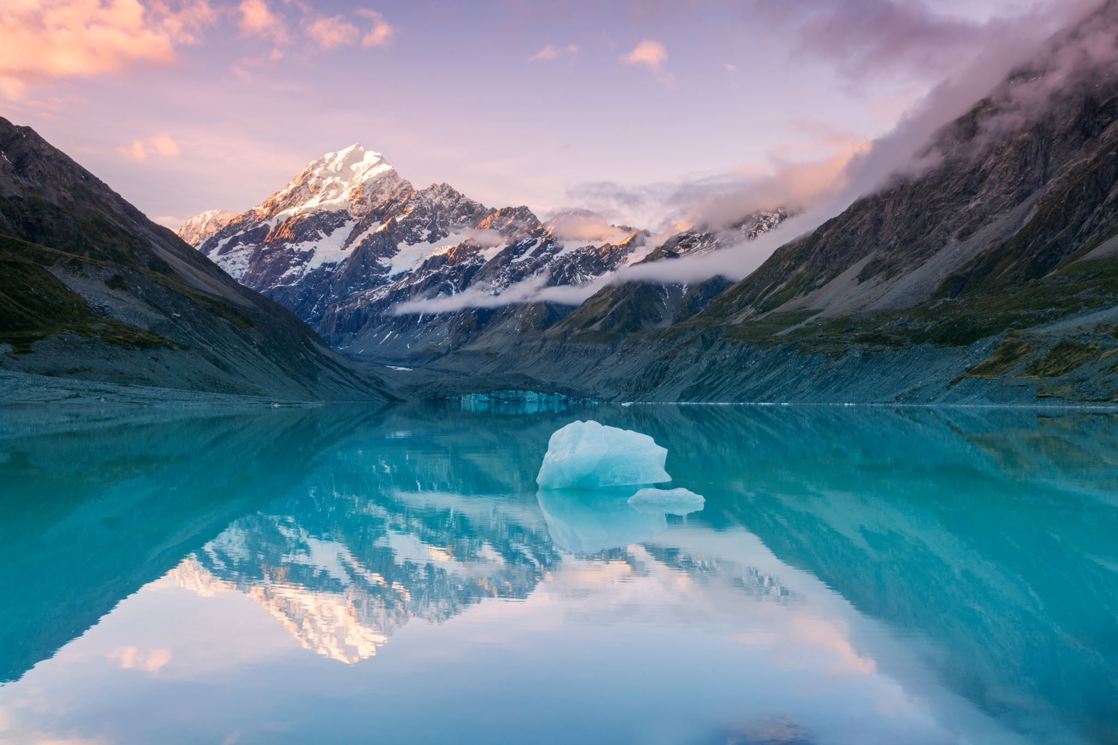
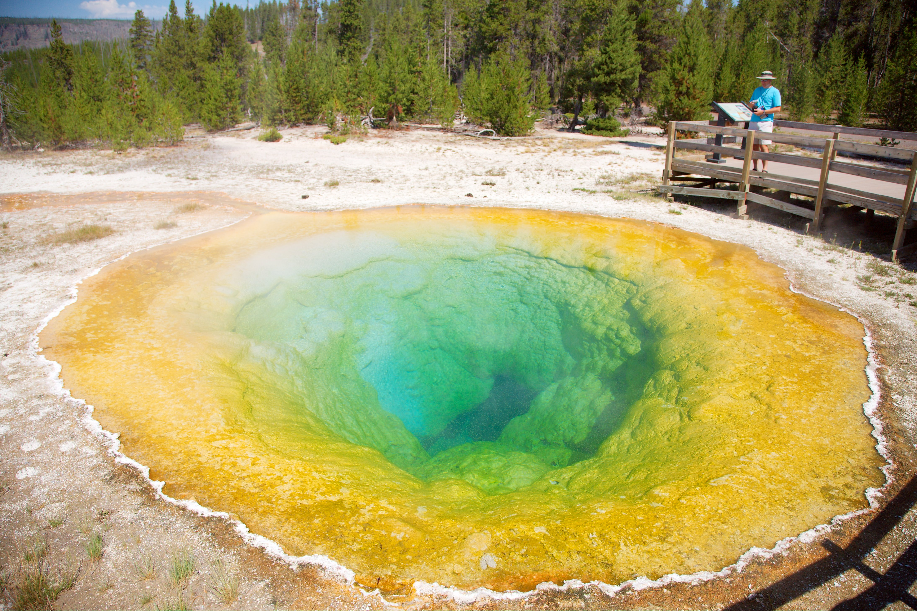


May/June
National Parks Spotlight
Careers in Environmental Science
Final Exam
This Photo by Unknown Author is licensed under CC BY-SA

